Slide 1
An Illustrative Machine Language
-It is how instructions of a typical computer are encoded.
The encoded version of a machine Instruction consists of two parts:
---The op-code (Operation Code
---The operand field.

Slide 2
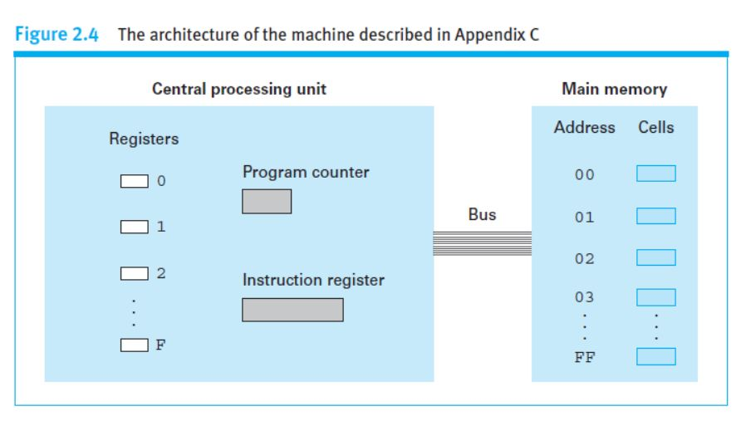
The op-code is the portion of a machine language instruction that specifies the operation to be performed.
- The bit pattern appearing in the op-code field indicates which of the elementary operations, such as STORE, SHIFT, XOR and JUMP is requested by the instructions.
Consists of 12 basic instructions, each instructions is encoded using a total of 16 bits, represented by four hexadecimal digits.
The opcode for each instruction consist of 4 bits.

Slide 3
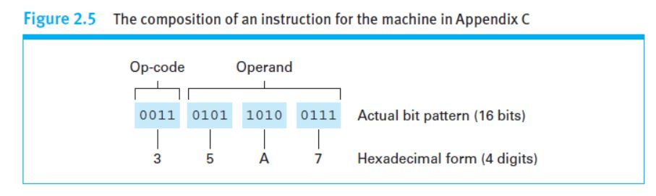
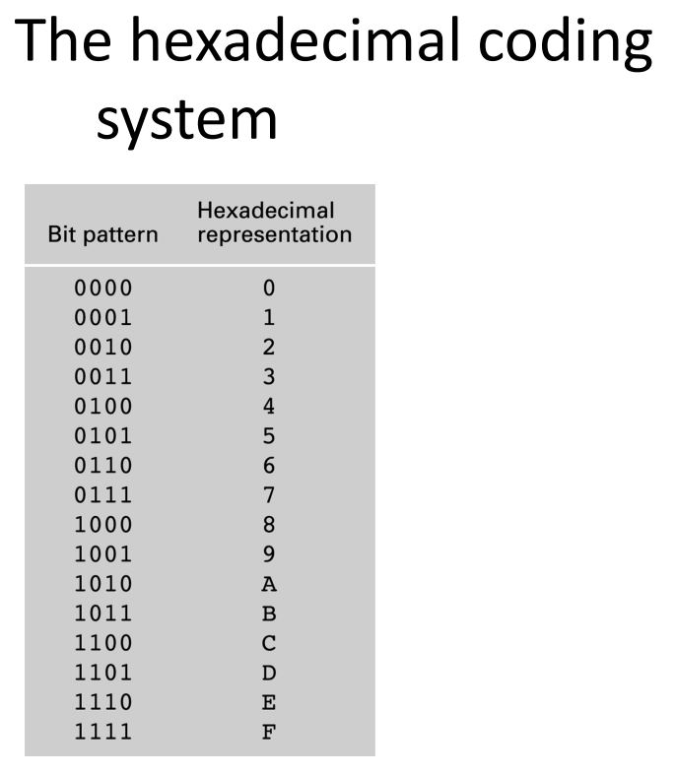

Slide 4
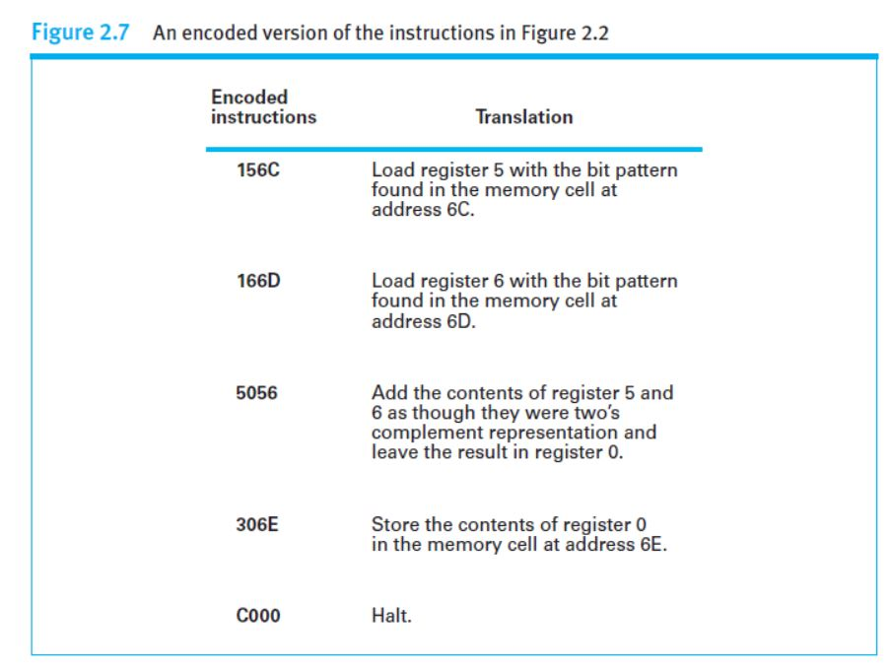
Operand field is used to clarify the general instruction given by the op-code
Op-code and operand is merely in how instructions are encoded.
Op-code 1 identifies an instruction that loads a register with the content of a memory cell.
Whereas the op-code 2 hexadecimal identifies an instruction that loads a register with a particular value.

